Slide 1
Sara Pricilla.A
Final Project

Slide 2
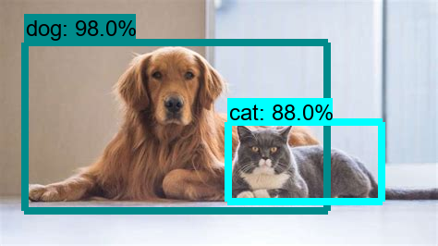
PROJECT TITLE
Object detection using Tensorflow

Slide 3


AGENDA
PROBLEM STATEMENT
PROJECT OVERVIEW
THE END USERS OF THE PROJECT
SOLUTION OF THE PROJECT
THE WOW IN YOUR SOLUTION
MODELLING
RESULT
CONCLUSION
3/21/2024 Annual Review

Slide 4

PROBLEM STATEMENT
The project is to develop an object detection system using TensorFlow(open source machine learning platform) that can accurately detect and localize objects of interest within images or video streams. The system should be capable of identifying multiple object classes in real-time and provide bounding box annotations around detected objects by Choosing an appropriate object detection model architecture supported by TensorFlow, such as SSD, Faster R-CNN, or YOLO. The selected model should be trained using the annotated dataset to learn to detect and classify objects accurately.

Slide 5

PROJECT OVERVIEW
The project will begin with data preparation, involving the collection of a diverse dataset containing annotated images with bounding boxes for different object classes. Using the dataset, we will select and train a suitable object detection model architecture, leveraging TensorFlow's flexibility and scalability. The trained model will then be integrated into a real-time object detection pipeline. Throughout the project, thorough evaluation will be conducted to assess the accuracy and efficiency of the developed system, with a focus on meeting the objectives outlined in the problem statement. Finally, the project will conclude with a comprehensive analysis of the results obtained and suggestions for future enhancements and research directions.

Slide 6
WHO ARE THE END USERS?
The end users of object detection systems using TensorFlow can extend to any industry or domain where the detection and localization of objects within images or video streams are essential for decision-making.
Autonomous Vehicle Manufacturers
Surveillance and Security Companies
Retail and E-commerce Platforms
Smart Cities and Public Safety Agencies
Educational Institutions and Researchers
Content Moderation and Social Media Platforms
Healthcare Providers

Slide 7

YOUR SOLUTION AND ITS VALUE PROPOSITION
The YOLO algorithm is selected as the object detection model architecture. TensorFlow provides resources for implementing YOLO-based models efficiently. With the model architecture chosen, training begins. The TensorFlow framework allows for the configuration of the YOLO model and training on the prepared dataset. During training, hyperparameters are adjusted to optimize performance, and the model's progress is monitored. Once the training is complete, the trained YOLO model is deployed.. Testing and validation are conducted to ensure the deployed YOLO-based object detection system meets performance and reliability requirements. The system's accuracy and robustness are evaluated under different conditions and scenarios

Slide 8

THE WOW IN YOUR SOLUTION
Using yolo offers several benefits like
Real-Time Performance
Unified Detection
Flexibility
Object Tracking
Similarly TensorFlow offers
A high degree of flexibility, allowing developers to create and train custom deep learning models for various tasks, including object detection. It provides a wide range of pre-implemented neural network layers and optimization algorithms, facilitating model development and experimentation.
Features for production deployment, such as TensorFlow Extended (TFX) for building end-to-end machine learning pipelines.
3/21/2024 Annual Review
8

Slide 9
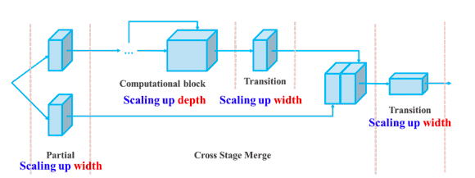
MODELLING
1.import the libraries
2.load data into dataframe
3.transform data into tf dataset
4.load yolov8 using keras_cv
5.train the model
6.evalution
9

Slide 10
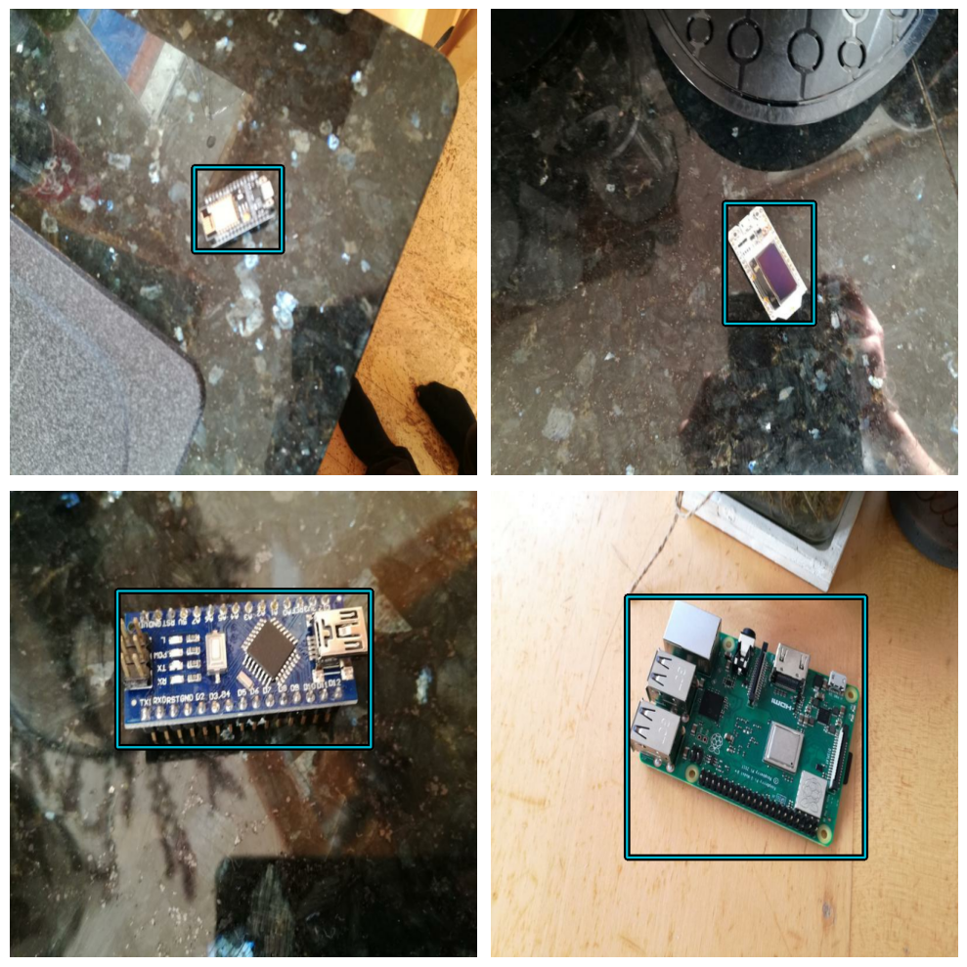
RESULTS
Microcontroller is detected accurately and the model is well trained
10

Slide 11
CONCLUSION
Object detection with TensorFlow offers a powerful and versatile solution for a wide range of applications across various domains. Through the utilization of deep learning architectures such as YOLO, TensorFlow enables the development of accurate and efficient object detection models capable of detecting and localizing objects within images or video streams in real-time.

